Slide 2
Jeremiah 42:1-6
Imagine living in the last days of Judah!
2 Kings 23:25 – Josiah a wonderful king – no King was like him!
But he was killed by the king of Egypt – 2 Kings 23:28,29
Jehoahaz succeeded him – 3 months! 2 Kings 23:31-33
Eliakim in his place, renamed Jehoiakim – 2 Kings 23:34
Three years into reign, Killed by Nebuchadnezzar – 2 Kings 24:1-4
18 Year old son, Jehoiachin, reigned until Nebuchadnezzar besieged Jerusalem – 2 Kings 24:8, 12-14

Slide 3
Imagine living in the last days of Judah!
Zedekiah appointed by Nebuchadnezzar – 2 Kings 24:18-20
God told Zedekiah to submit to Nebuchadnezzar – Jeremiah 27:1-7, 8-10
The benefits of obeying God – Jeremiah 27:11
Babylon would not remain in power for long – Jeremiah 27:7
Told to stay put! Jeremiah 42:7-12
God warned them – Jeremiah 42:13-17

Slide 4
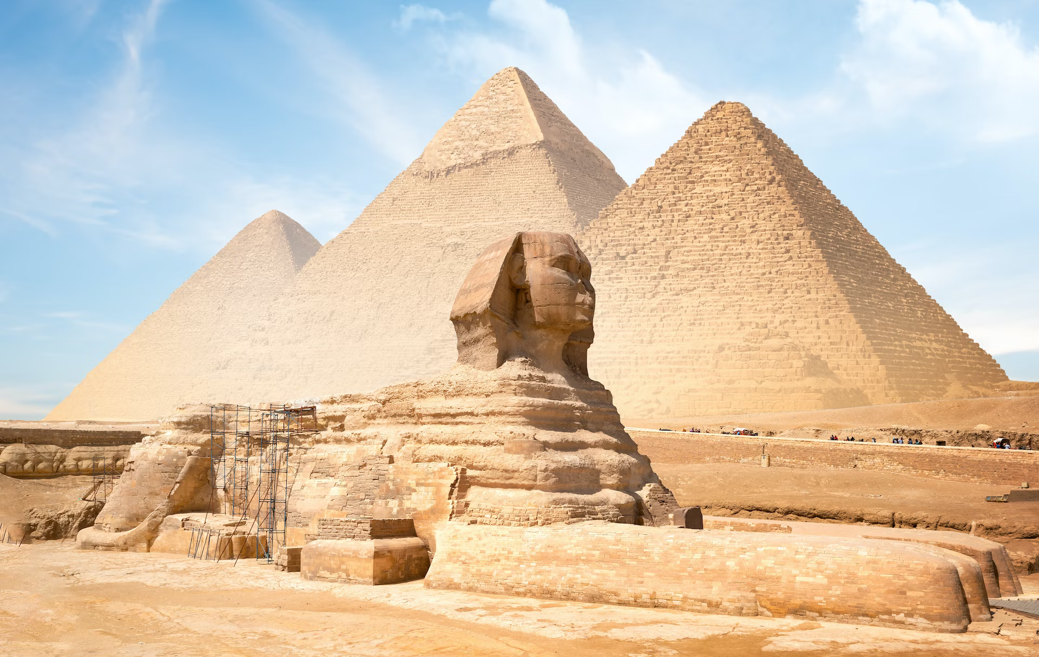
“Do not go to Egypt!” Jeremiah 42:18-22

Slide 5
People Decided Jeremiah Was Lying To Them!
Jeremiah 43:1-7 “So they went to the land of Egypt, for they did not obey the voice of the LORD”
God was NOT HAPPY! Jeremiah 44:26-28 “ I will watch over them for adversity and not for good”
Why did the people reject the SAFEST OPTION?
They were AFRAID!
They felt they had to do SOMETHING!
God told them to WAIT!
Waiting harder than doing something difficult!

Slide 6
WAIT FOR GOD!
See evil around us and feel something MUST be done!
God’s answer in not to worry about evil – Psalm 37:1-11
Don’t Take Vengeance – Proverbs 20:22
We have to be righteous and wait for God - Isaiah 25:7-12

Slide 7
We See Overwhelming Problems and We Despair
Need to trust that God loves His people – Psalm 33:18-22
We see OUR sins and FEAR – Psalm 130:1-3
Need to wait for God and put hope in His Word- Psalm 130:4-8
Wait for His Mercy – Psalm 123:1,2
Hosea 12:6 “wait on your God continually”

Slide 8
JOB
Looked at misery of his life and wondered- Job 21:7-9
Would not follow them – Job 21:16
Job endured – James 5:11
Being a Christian is not easy – Matthew 10:22
John faced tribulation – Revelation 1:9
Be faithful unto death – Revelation 2:10
Persevere -Revelation 3:10

Slide 9

1 Corinthians 15:58 NKJV 58 “Therefore, my beloved brethren, be steadfast, immovable, always abounding in the work of the Lord, knowing that your labor is not in vain in the Lord.”

